Slide 1

Architecture Billing Index
ARCH BILLINGS:
Effect on us 12-24 months later
Billings index
(greater than 50 = expansion
Architecture firm billings declined modestly in April as broader economic instability continued... “April’s economic picture was mixed as employers continued to add
jobs, but inflation accelerated as higher energy prices tied to the conflict in Iran drove up costs. While a proposed gas tax holiday could offer some shortterm relief, energy prices are unlikely to ease meaningfully until the
conflict ends.”
Weak business conditions at architectural firms
Apr score
48.3
– Richard Branch,
AIA Chief Economist
Source: American Institute of Architects, Architectural Billings Index (ABI)

Slide 2
Commercial vs. Institutional Architectural Billings
Billings index
(greater than 50 = expansion
Source: American Institute of Architects, Architectural Billings Index (ABI). 3MMA

Slide 3
Commercial, Institutional Multi-Family, & Mixed Architectural Billings
Billings index
(greater than 50 = expansion
Institutional
Commercial
Multi-Family
Mixed
Source: American Institute of Architects, Architectural Billings Index (ABI). 3MMA

Slide 4
Architectural Billings Index by US Region
Billings index
(greater than 50 = expansion
Midwest
South
West
Northeast
Source: American Institute of Architects, Architectural Billings Index (ABI). 3MMA

Slide 5
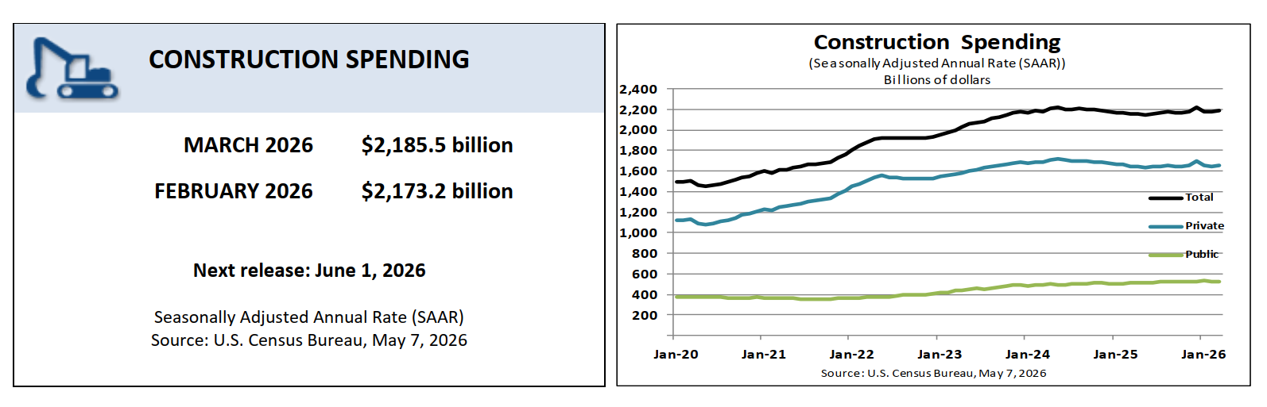
Total Construction Spending

Slide 6
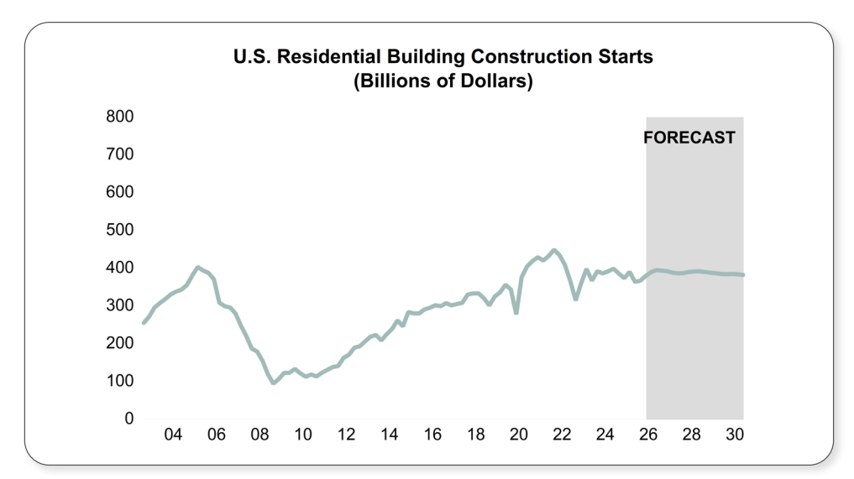
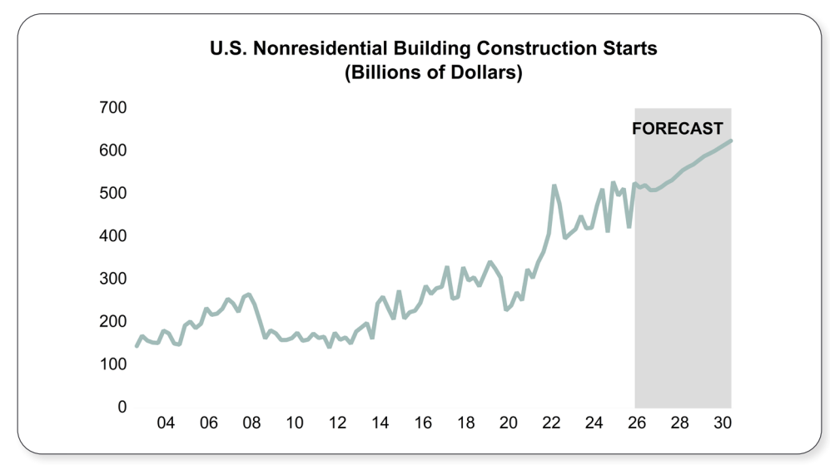
Dodge Outlook – Residential vs. Non-Residential

